Slide 1
Warranties for Faster Strong Consistency
 | Jed Liu | Tom Magrino |  | Owen Arden
 | Michael D. George |  | Andrew C. Myers
11th USENIX Symposium on Networked Systems Design and Implementation 4 April 2014

Slide 2
Consistency vs. scalability
Traditional RDBMSes
Today’s “web-scale” systems
Strong consistency
ACID guarantees
Simple to program
Don’t scale well
Weak (eventual) consistency
Offer better scalability
Difficult to program
Consistency failures affect higher software layers unpredictably
Consistency
Scalability
Warranties help bridge the gap

Slide 3
Consistency: how strong?
Strict serializability [Papadimitriou 1979]
Behaviour = sequential ordering (serializability)
Order of non-overlapping transactions preserved
Ensures transactions always see most recent state
External consistency [Gifford 1981]
Serialization consistent w/ wall-clock time of commits

Slide 4
Warranties
Warranty – a time-limited assertion about system state
State warranty – state of an object
Computation warranty – result of a computation
Duration can be set automatically, adaptively
Each warranty defended to ensure assertion remains true
Assume loosely synchronized clocks (e.g., NTP)
acct == {name: “Bob”, bal: 42} until 2:00:02 p.m. (2 s)
flight.seatsAvail(AISLE) >= 6 until 2:00:05 p.m. (5 s)
Warranties allow commits to avoid communication while guaranteeing strict serializability and external consistency

Slide 5
Distributed OCC refresher
compute
Clients compute on optimistically cached data
read
Scalable
Strongly consistent
Distributed transactions
Storage nodes (stores) store persistent data

Slide 6
Distributed OCC refresher
Clients compute on optimistically cached data
2PC:
prepare
commit
read prepare
write prepare
commit
commit
Storage nodes (stores) store persistent data

Slide 7
Distributed OCC refresher
Clients compute on optimistically cached data
Popular objects usually read more often than written
Client’s copy likely up to date
Why not guarantee freshness of cache?
Bottleneck at stores for popular objects
Storage nodes (stores) store persistent data

Slide 8
Warranties avoid communication
compute
Clients compute on optimistically cached data
read
Storage nodes (stores) store persistent data

Slide 9
Warranties avoid communication
Clients compute on optimistically cached data
Single-store optimization: one-phase commit
Warranties can eliminate read prepares
write commit
Storage nodes (stores) store persistent data

Slide 10
Warranties avoid communication
Clients compute on optimistically cached data
commit
Single-store optimization: one-phase commit
Warranties can eliminate read prepares
Read-only optimization: zero-phase commit
Storage nodes (stores) store persistent data

Slide 11
Using expired warranties
Clients compute on optimistically cached data
Expired warranties can be used optimistically
Single-store optimization: one-phase commit
extended warranty
read commit
Read-only optimization: zero-phase commit
revalidate
and extend
State warranties generalize OCC
(zero-duration warranties = OCC)
Storage nodes (stores) store persistent data

Slide 12
Warranties are related to read leases
Leases [GC89] give time-limited rights to resources
e.g., use IP address, read object, write object
Must have lease to perform corresponding action
Can relinquish lease when no longer needed
Allow outsourcing of consistency to clients
Warranties: a shift in perspective
Time-limited assertions: “What’s true in the system?”
Some overlap: state warranties similar to read leases
Naturally generalize to computation warranties

Slide 13
Memoized methods
One lightweight way to present computation warranties in language
e.g., extend Java:
memoized = issue warranties
on method result
Memoized
method
declaration
memoized boolean seatsAvail(SeatType t, int n) {
return seatsAvail(t) >= n;
}
for (Flight f : flights)
if (f.seatsAvail(AISLE, 3))
displayFlights.add(f);
Client code
(ordinary Java)

Slide 14
Using computation warranties
Client
f.seatsAvail(AISLE, 3) == true
true
f.seatsAvail(AISLE, 3) == ?
Store
f.seatsAvail(AISLE, 3) == true
for (Flight f : flights)
if (f.seatsAvail(AISLE, 3))
displayFlights.add(f);

Slide 15
Proposing computation warranties
Client
f.seatsAvail(AISLE, 3) == true
f.seatsAvail(AISLE, 3) == ?
true
f.seatsAvail(AISLE, 3) == true
commit
Store
f.seatsAvail(AISLE, 3) == true
for (Flight f : flights)
if (f.seatsAvail(AISLE, 3))
displayFlights.add(f);

Slide 16
Warranty dependencies
Computation warranties can depend on other warranties
Warranty dependency tree
memoized int f() {
return g() + 1;
}
memoized int g() { … }
f()
computation warranties
g()
state warranties

Slide 17
Twitter analytics example
Who are the top N most-followed Twitter users?
Unlikely to change often, though followers change frequently
Divide & conquer implementation
Allows incremental computation of new warranties
Warranty dependency tree
compute
top(N,i,j)
top(N,i,k₀)
top(N,k₀,j)
top(N,i,k₁)
top(N,k₁,k₀)
…
…
users

Slide 18
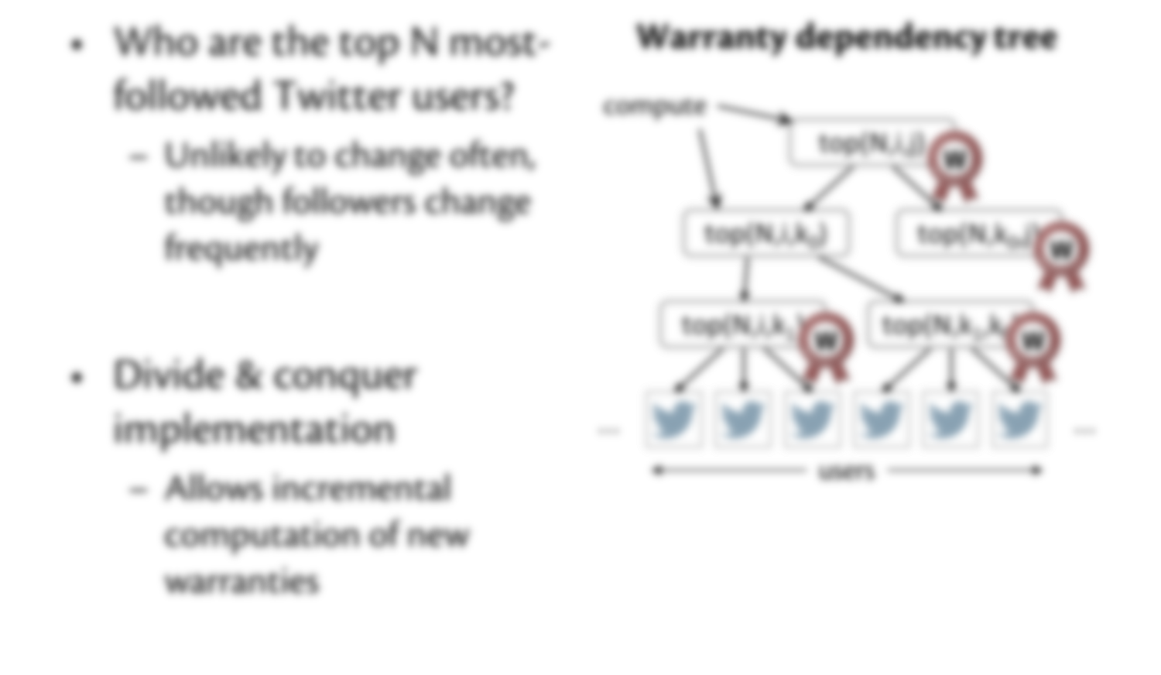
Twitter analytics example
Why not memoize all the methods?
Not all methods memoizable

Slide 19
Not all methods memoizable
Behaviour should be identical regardless of whether warranty is used
Memoized computations must:
Be deterministic
Have no observable side effects
i.e., cannot modify pre-existing objects

Slide 20
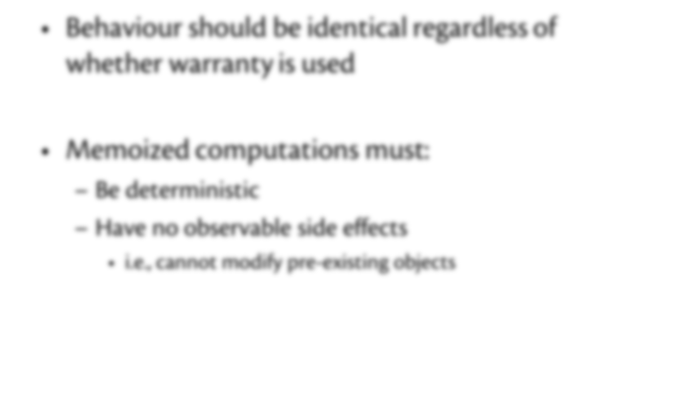
Not all methods memoizable
Let’s memoize all the other methods!
Warranties aren’t free:
Creation & bookkeeping have cost
Need to be defended against writes that invalidate them

Slide 21
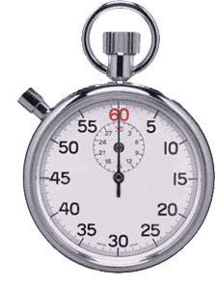
Defending state warranties
Writes delayed until conflicting warranties expire
Client sends update to store
Store notices conflicting warranty
Write is delayed
Client notified of delayed commit
Update commits when warranty expires
Client
commit
commit at 4 p.m.
Store
expires
4 p.m.
Pending writes

Slide 22
Defending computation warranties
Writes delayed until conflicting warranties expire
Warranty dependency tree
Client
top(N,i,k₁)
commit
commit at 4 p.m.
top(N,i,k₁) ==
Store
top(N,i,k₁) ==
Pending writes
expires
4 p.m.

Slide 23
Defending computation warranties
Writes delayed until conflicting warranties expire
Warranty dependency tree
Client
top(N,i,k₁)
commit
committed
top(N,i,k₁) ==
Store
top(N,i,k₁) ==
Pending writes
expires
4 p.m.

Slide 24
Warranty durations
Warranties can delay writes
Key to performance: warranty durations
Long enough to be useful
Short enough to keep writers from blocking
Automatic, adaptive, online mechanism
Analytical model driven by run-time measurements
Frequently used & seldom changed |  | long warranties
Frequently changes or seldom used |  | short warranties (if any at all)

Slide 25
Trade-offs
Unavoidable trade-off between readers & writers
Read performance improved, but writes delayed
OCC
writers abort readers
Pessimistic locking
writers wait for read locks
Warranties
writers wait for
warranties to expire

Slide 26
Implementation
Extended Fabric [SOSP 2009]
Secure distributed object system
High-level programming model
Presents persistent data as ordinary language-level objects
Support for both state & computation warranties
Fabric language extended with memoized methods
Fabric 0.2.1 | 44 | kLOC
Warranties extension | 7 | kLOC added or modified

Slide 27
Evaluation: state warranties
Multiuser OO7 benchmark
Models OODBMS applications
Heavyweight transactions (~460 objects involved)
Changed to model popularity of reads (power law)
Increases read/write contention (harder to scale)
Ran on Eucalyptus cluster
Stores: 2 cores, 8 GB memory
Clients: 4 cores, 16 GB memory

Slide 28
Scalability
2% writes
36 clients
~400 tx/s per additional store
Little improvement: bottlenecked at stores w/ popular objects

Slide 29
Effect of read/write ratios
3 stores
24 clients
Median write delay: 0 ms
70-80% of writes commit immediately

Slide 30
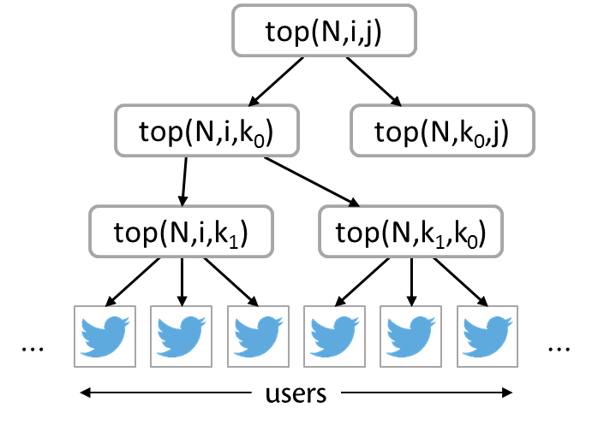
Evaluation: computation warranties
Twitter benchmark
1,000 users
98% reads (compute top-5 users)
2% writes (follow/unfollow random user)
Speedup by giving application-specific consistency
 | Throughput (tx/s) |  |  | Median latency (ms) |  |  | 95th percentile write delay (ms)
Fabric | 17 | ± | 4 | 568 | ± | 354 | —
State warranties | 26 | ± | 5 | 1239 | ± | 455 | 623 | ± | 274
Comp. warranties | 343 | ± | 10 | 12 | ± | 2 | 16 | ± | 4

Slide 31
Evaluation: Cornell CS CMS
Web app for managing assignments & grading
Ported to Hibernate (JPA implementation)
Hibernate: popular ORM library for building web apps
Ran in “optimistic locking” mode
Emerging best practice
Also ported to Fabric
Workload based on 3-week trace from production CMS in 2013

Slide 32
CMS throughput

Slide 33
CMS scalability

Slide 34
Related work
Promises [JFG 2007] generalize leases
Specify resource requirements w/ logical formulas
Given time-limited guarantees about resource availability
Spanner [CDE+ 2012] – distributed transaction system w/ strict serializability
Lower level programming model, no computation caching
TxCache [PCZML 2010] – application cache w/ transactional consistency
Weaker consistency model
Escrow transactions [O’Neil 1986]
Transactions can commit when predicate on state is satisfied
Focused on allowing updates to commit more frequently
Warranties is the first to provide strong consistency by defending client caches

Slide 35
Warranties for Faster Strong Consistency
Jed Liu | Tom Magrino | Owen Arden | Michael D. George | Andrew C. Myers
Warranties help bridge the gap between consistency and scalability
Consistency
Scalability
Defend client caches
Commits avoid communication
Strict serializability
External consistency

